Slide 1
PJLI Micro-Loans Management System (E-Pahiram)
www.collaberadigital.com

Slide 2
Personal BACKGROUND
(Name, Past Experience, Qualification, Career Summary)
Name : Johnjason M. Coligado
Qualification: Tech Stack
Programming Languages & Database: C#, C++, Python, Java, and MsSQL.
Frameworks: Asp.net, Asp.net Core
Deployment Tools: Docker & Kubernetes
Game Development: Unity 3D
Career Summary :
Graduated with a BS Computer Engineering degree, has the title for the best capstone project (A.Y 2021-2022) entitled Arduino Based Kine Bike Simulation, and is also one of the capstone studies published and patented by the Laguna State Polytechnic University San Pablo City Campus. Former Vice President External of the Association of Students in Computer Engineering (ASCpE), one of the Trainee students of Continental Temic Philippines absorbed as Jr. IT Engineer.

Slide 3
Personal BACKGROUND
(Name, Past Experience, Qualification, Career Summary)
Name : Jhansept Kylo Pandanan
Qualification : Tech Stack
Programming Languages & Database: C#, C++, Python, Java, and MsSQL.
Frameworks: Asp.net, Asp.net Core
Deployment Tools: Docker & Kubernetes
Career Summary : Jhansept Kylo Pandanan, a graduate of Computer engineering. The former Vice-President Internal of the Association of Students in Computer Engineering of their University. Had his Internship at Automated Technologies Inc. from May 2022 to July 2022 - working along with the Network engineers to provide support and assistance in building and configuring physical servers.

Slide 4
Key Takeaways/Learnings from the Program (HTD)
Database Management:
Data normalization
Stored procedure
Asp.NET Framework
Dependency
Validations
MVC
Roles/Authorizations
Web API (Rest API)
Swagger
Postman
End points
Docker & Kubernetes
Deployment
Containerization

Slide 5
Problem Statement of the Capstone Project
The proposed solution is to create a loan management system that will streamline the gadget loan process, provide unique perks and facts about the offered loan, and enable customers to track the progress of their purchase. The loan calculator will also be incorporated, which will enable customers to estimate the total cost of the loan. This system will ensure transparency, provide a seamless experience for customers, and increase customer satisfaction.

Slide 6
Approach Note
This study refers to the current PJLI micro-loans website. The loan management system was built using Asp.Net MVC and dedicated frameworks, all data was handled with MsSQL and Entity Relationships, it was designed with bootstrap and css components, and it will be deployed with docker and kubernetes.
Approach:
Planning Phase
ER Diagram and Wireframe creation
Implementation
Deployment

Slide 7
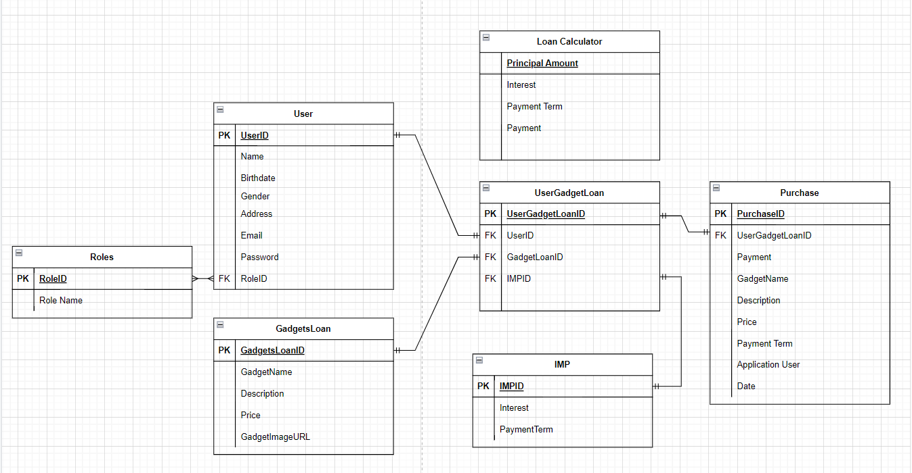
ER Diagram

Slide 8

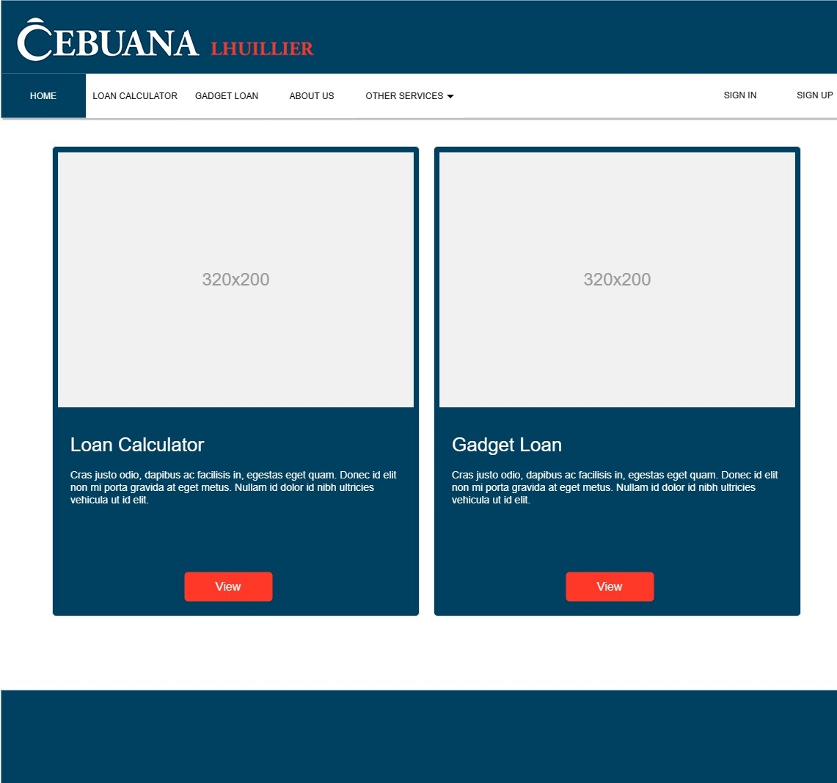

Wireframe/Architecture
www.collaberadigital.com

Slide 9
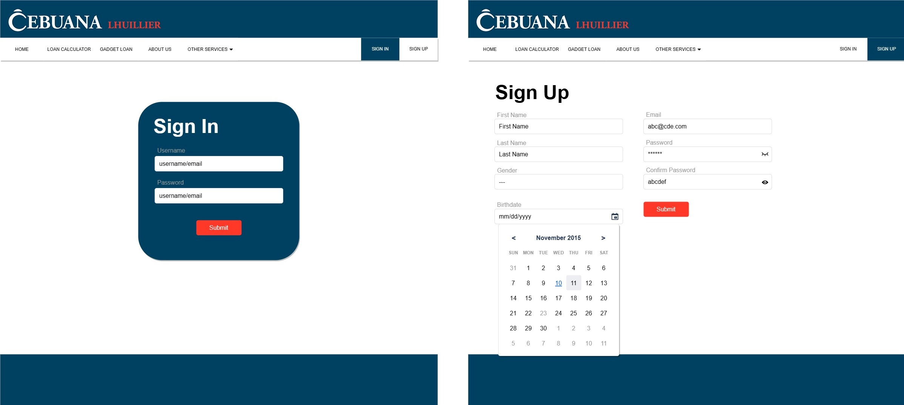
Wireframe

Slide 10
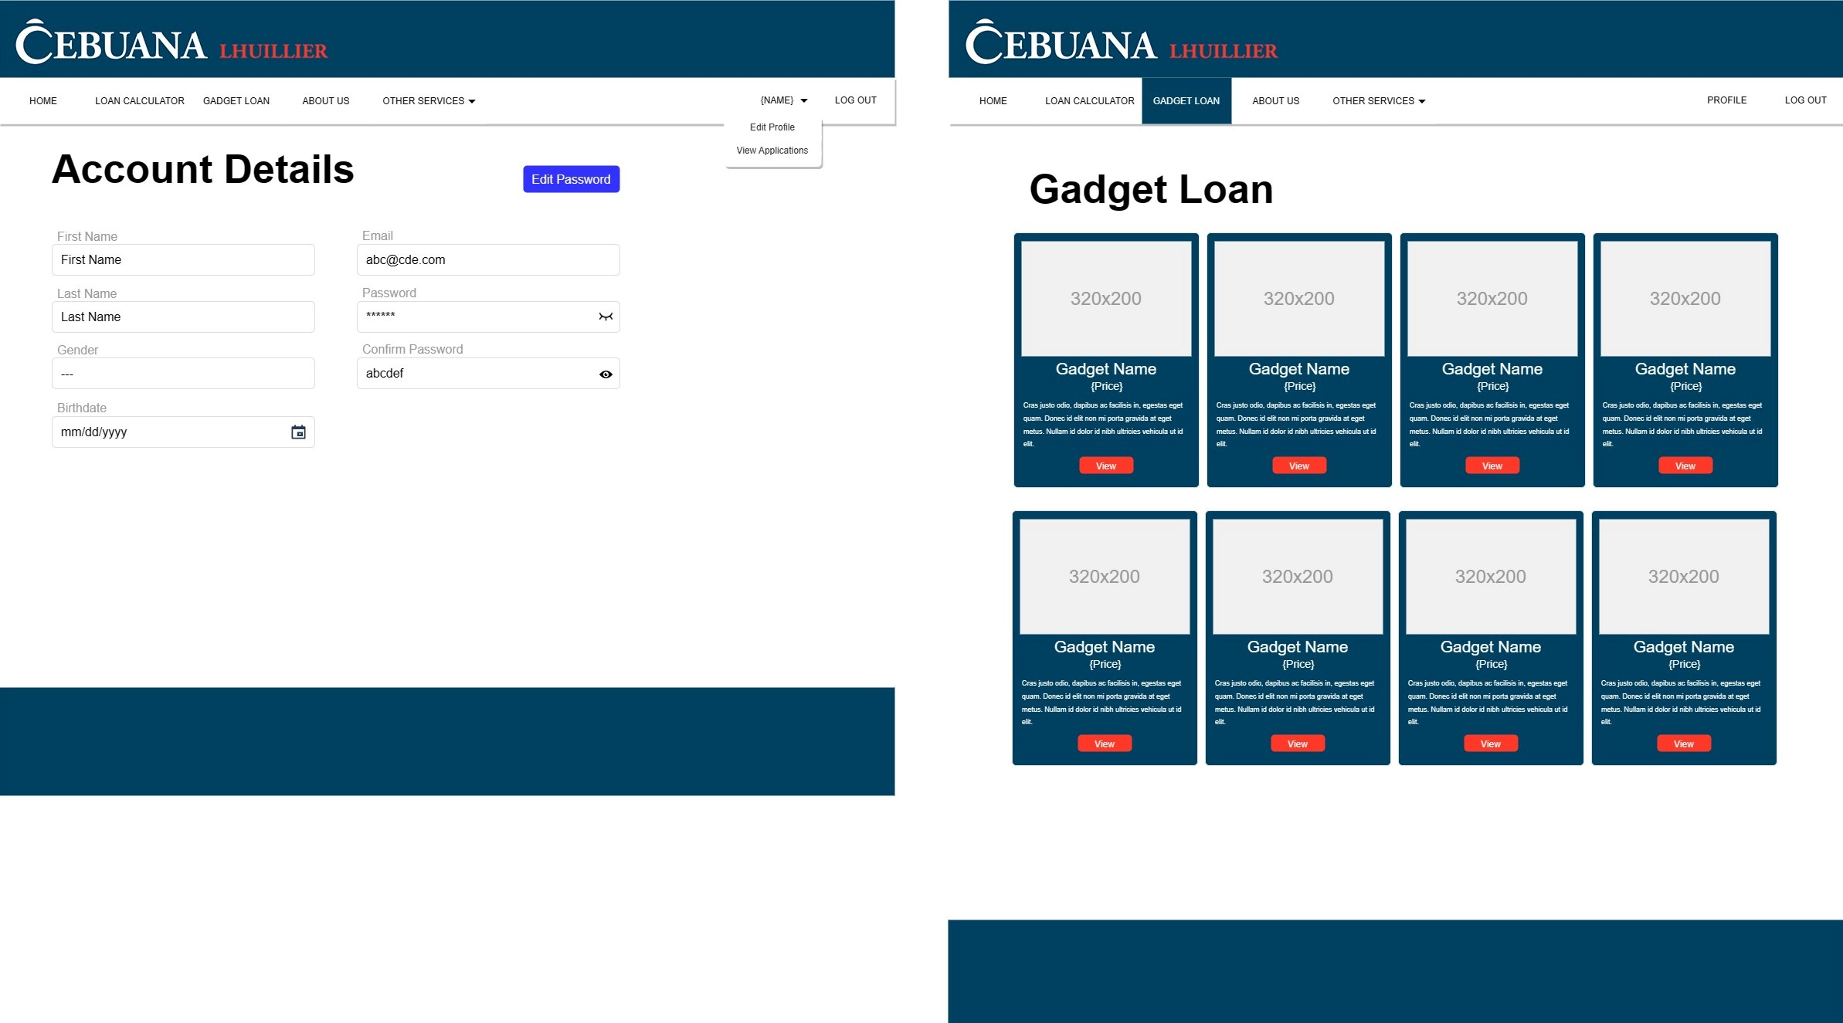
Wireframe

Slide 11
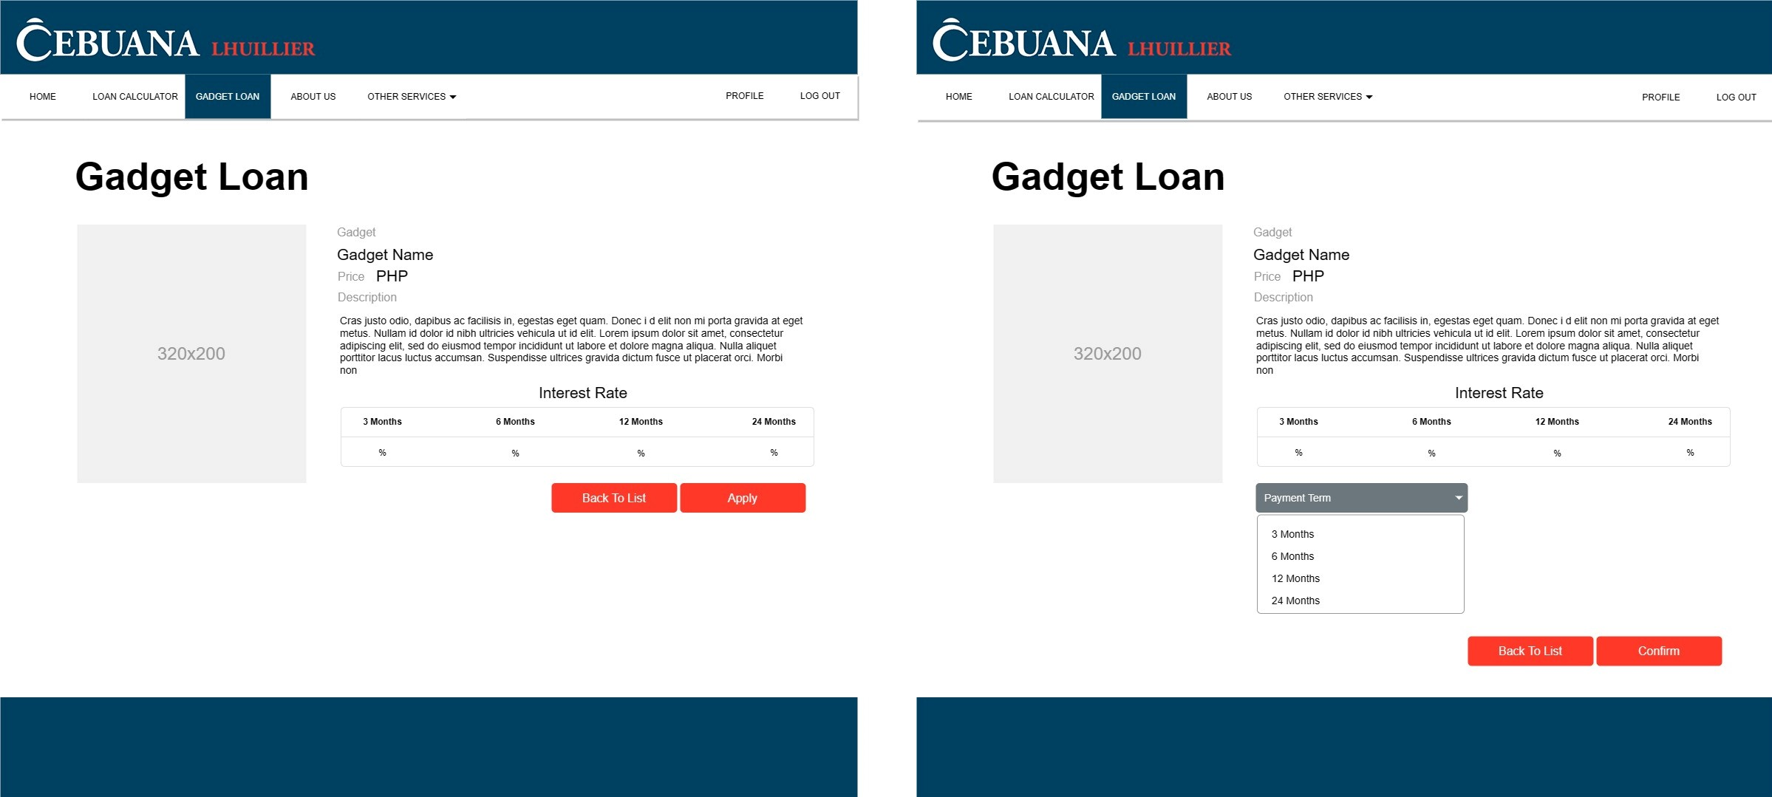
Wireframe

Slide 12
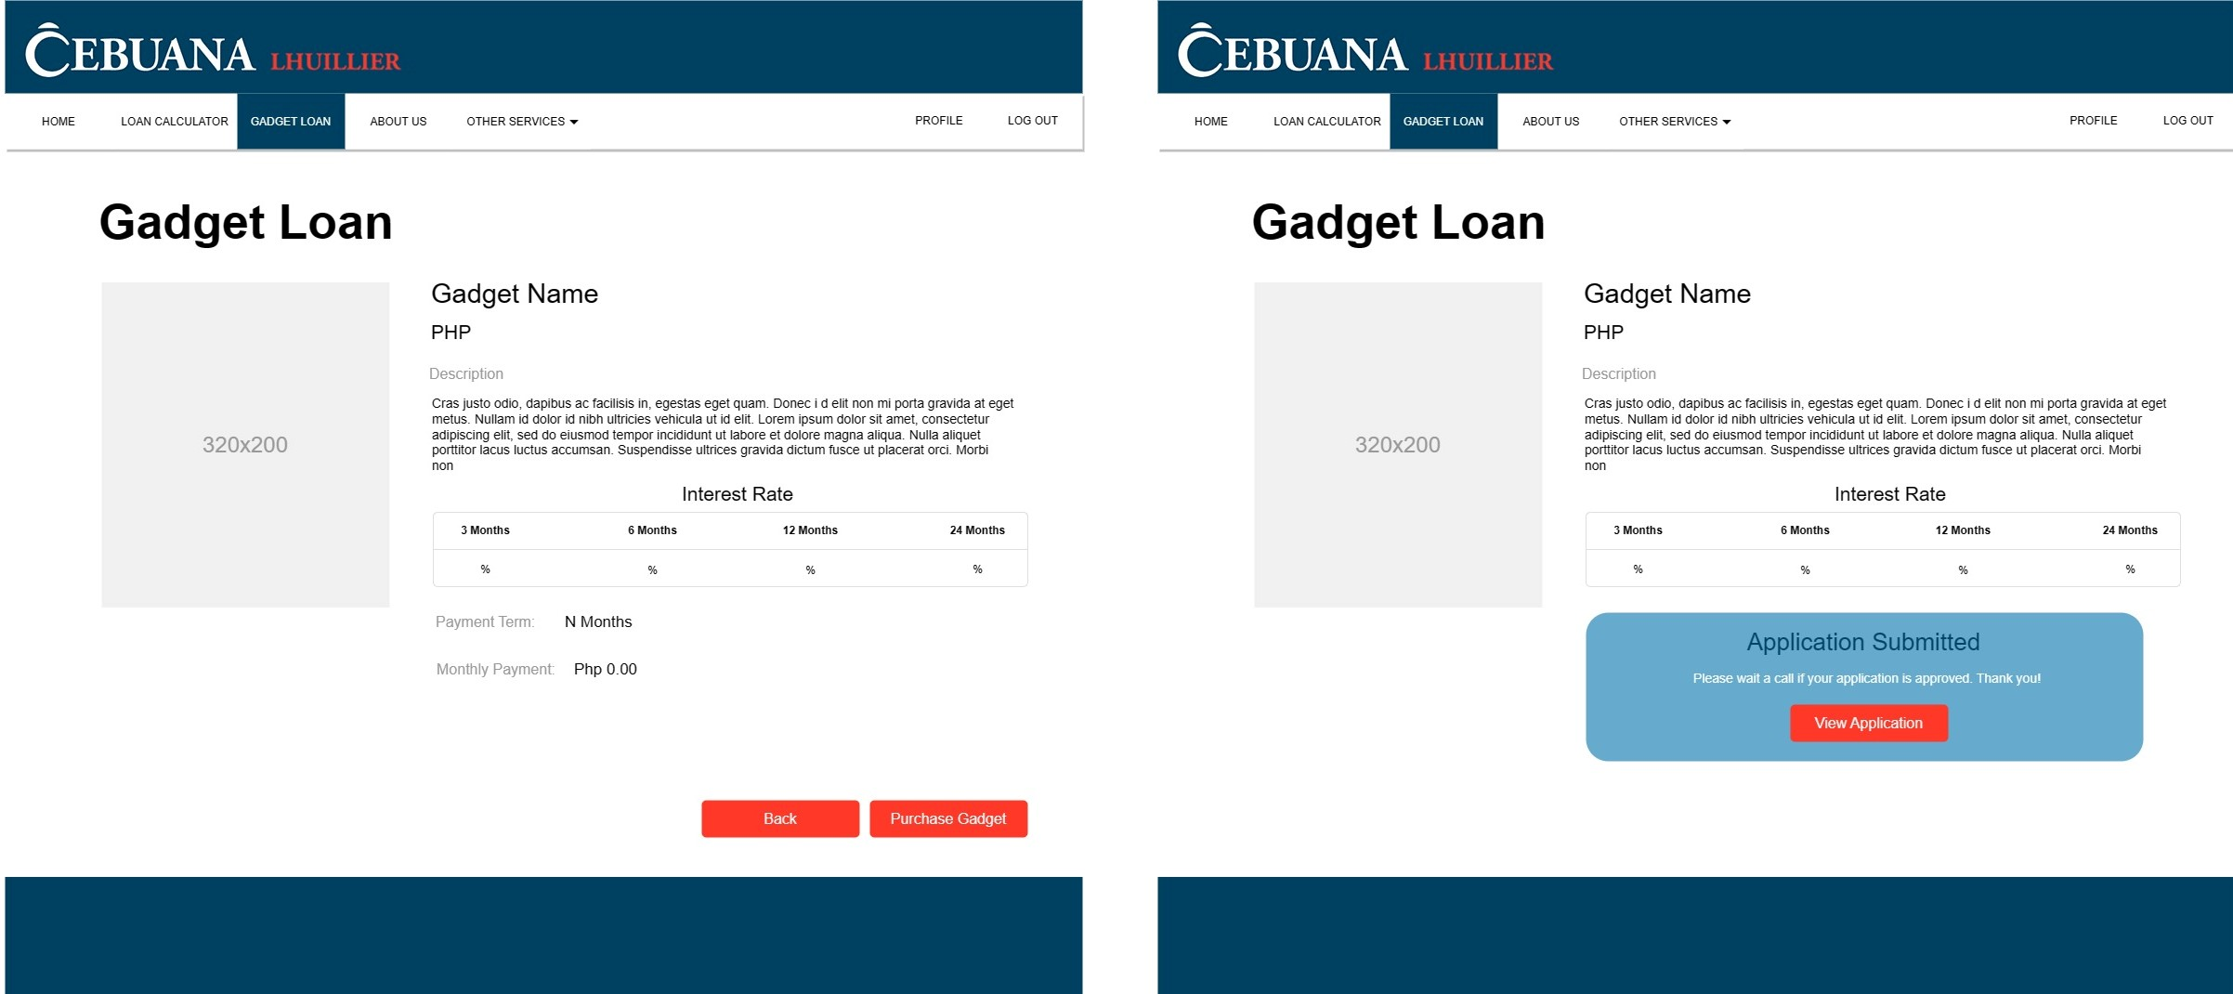
Wireframe

Slide 13
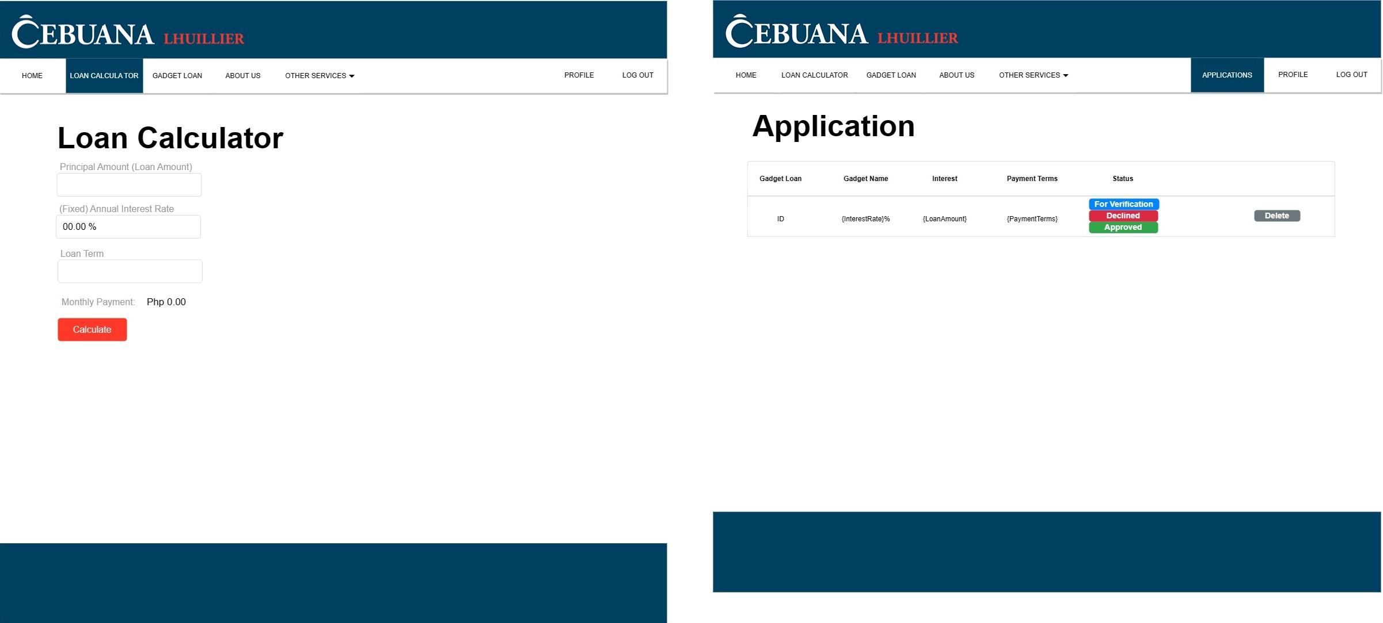
Wireframe

Slide 14
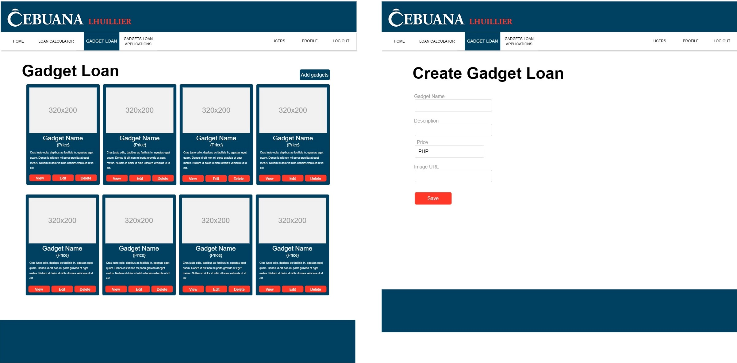
Wireframe

Slide 15
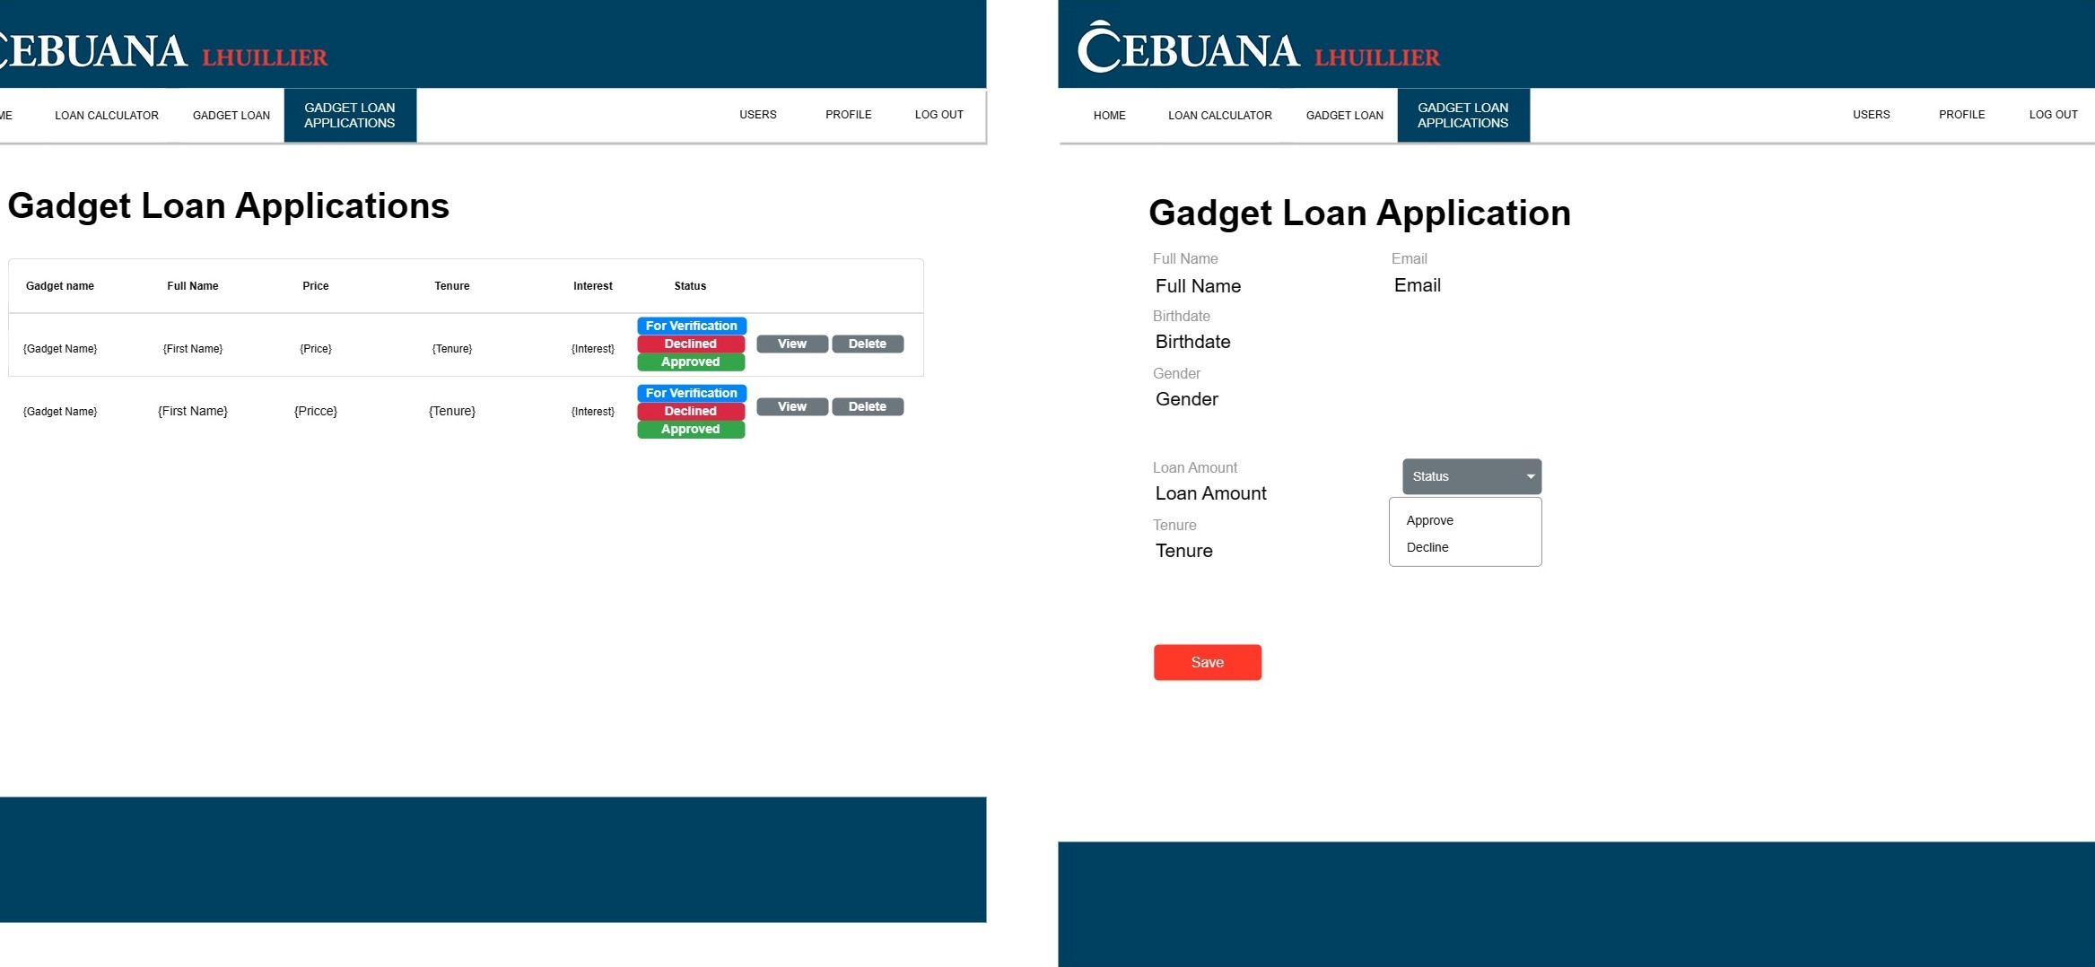
Wireframe

Slide 16
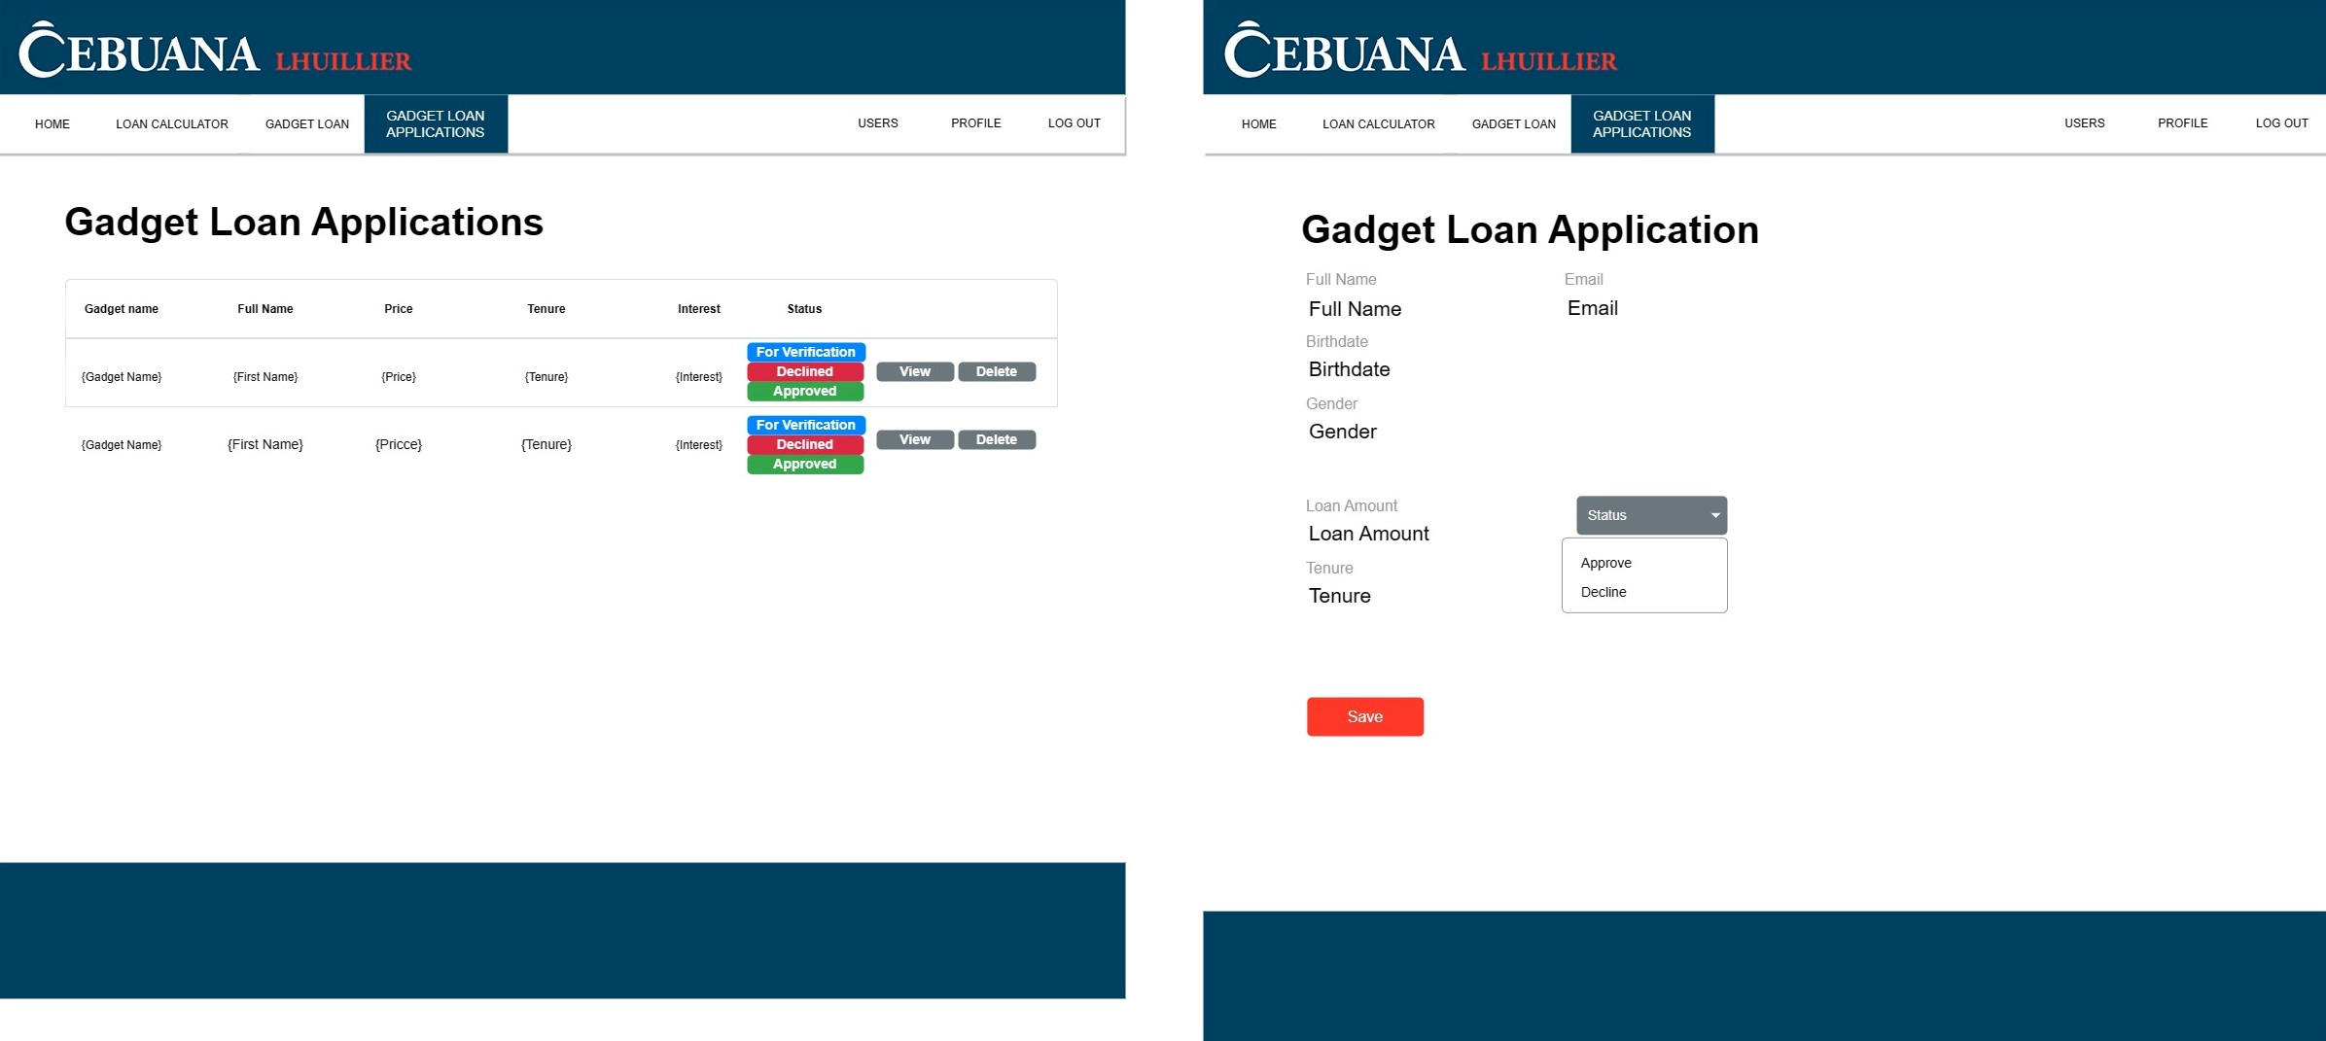
Wireframe

Slide 17
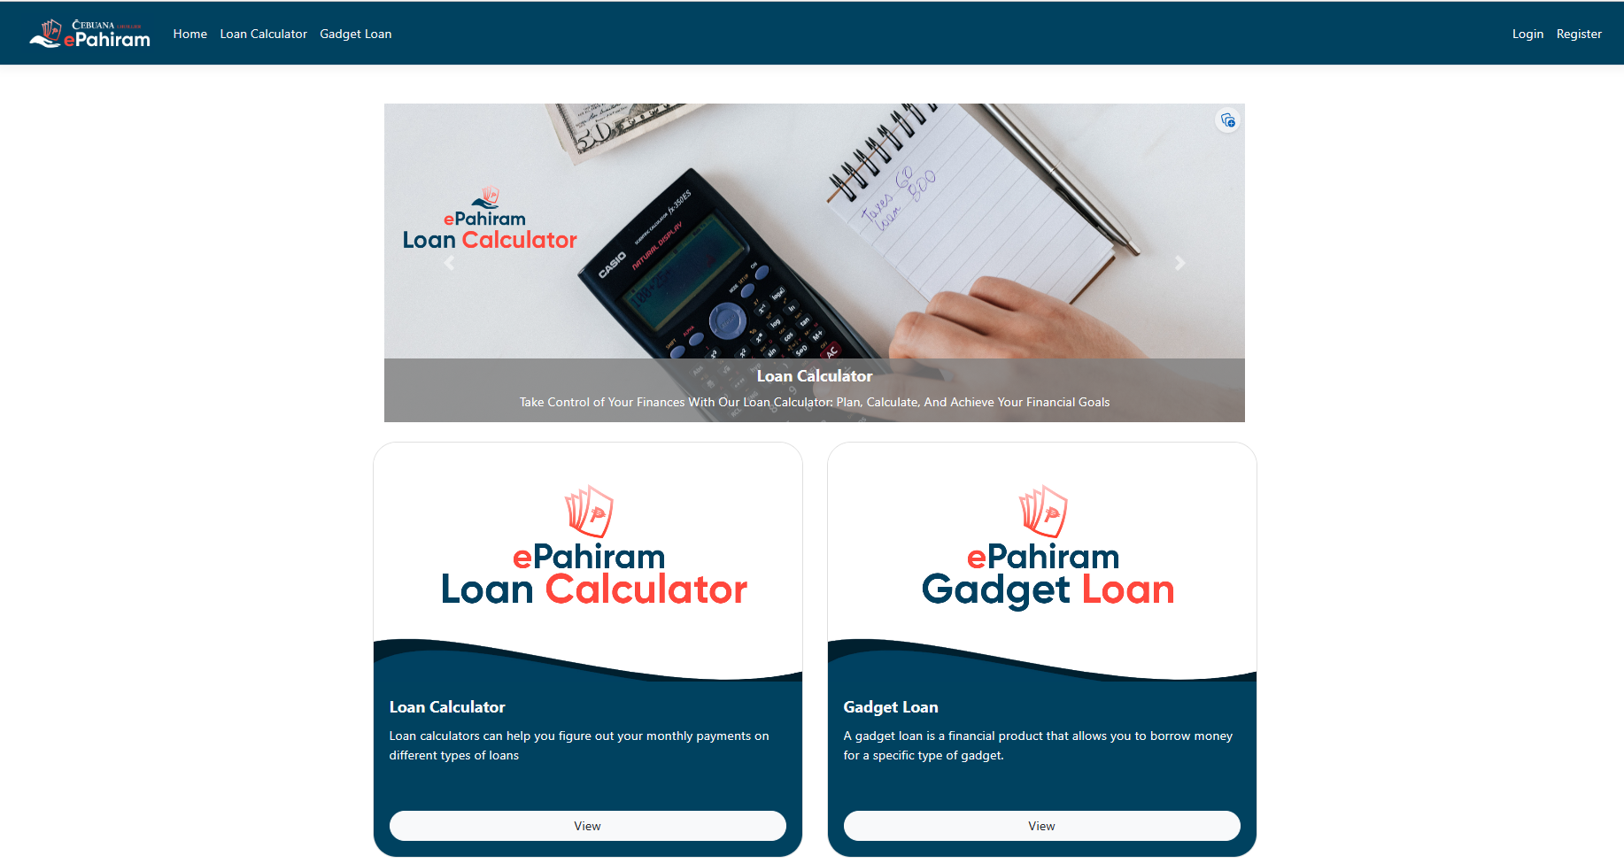
Important Features

Slide 18
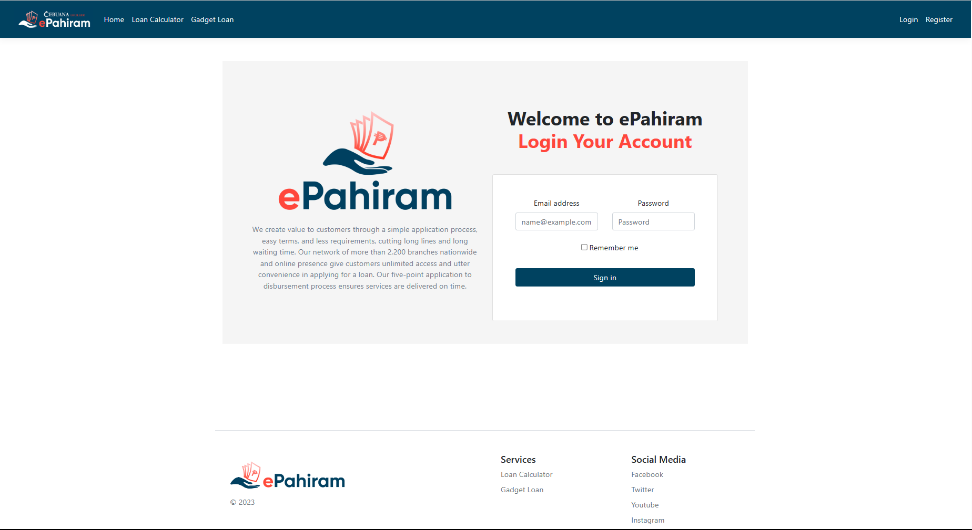
Important Features

Slide 19
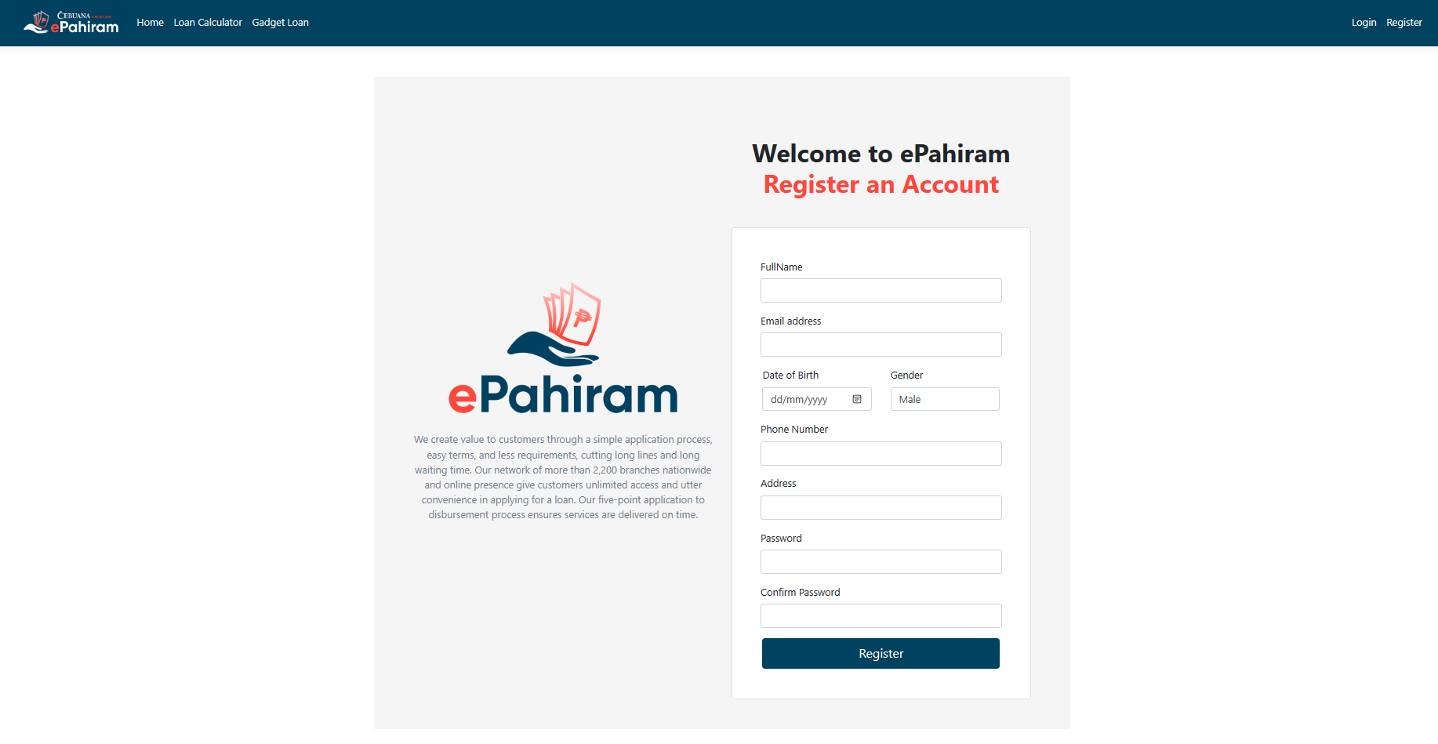
Important Features

Slide 20
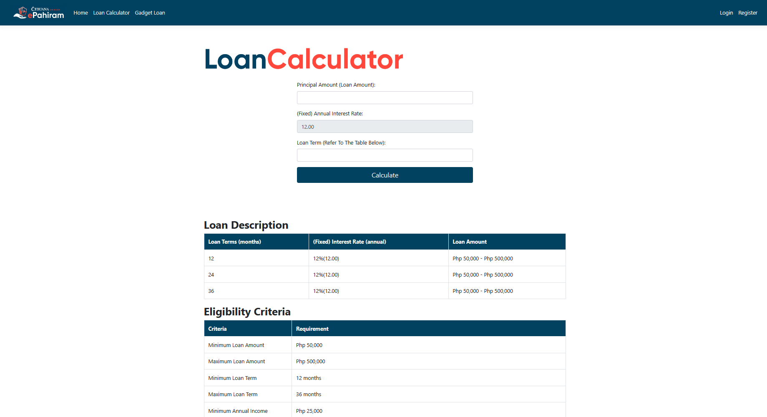
Important Features

Slide 21
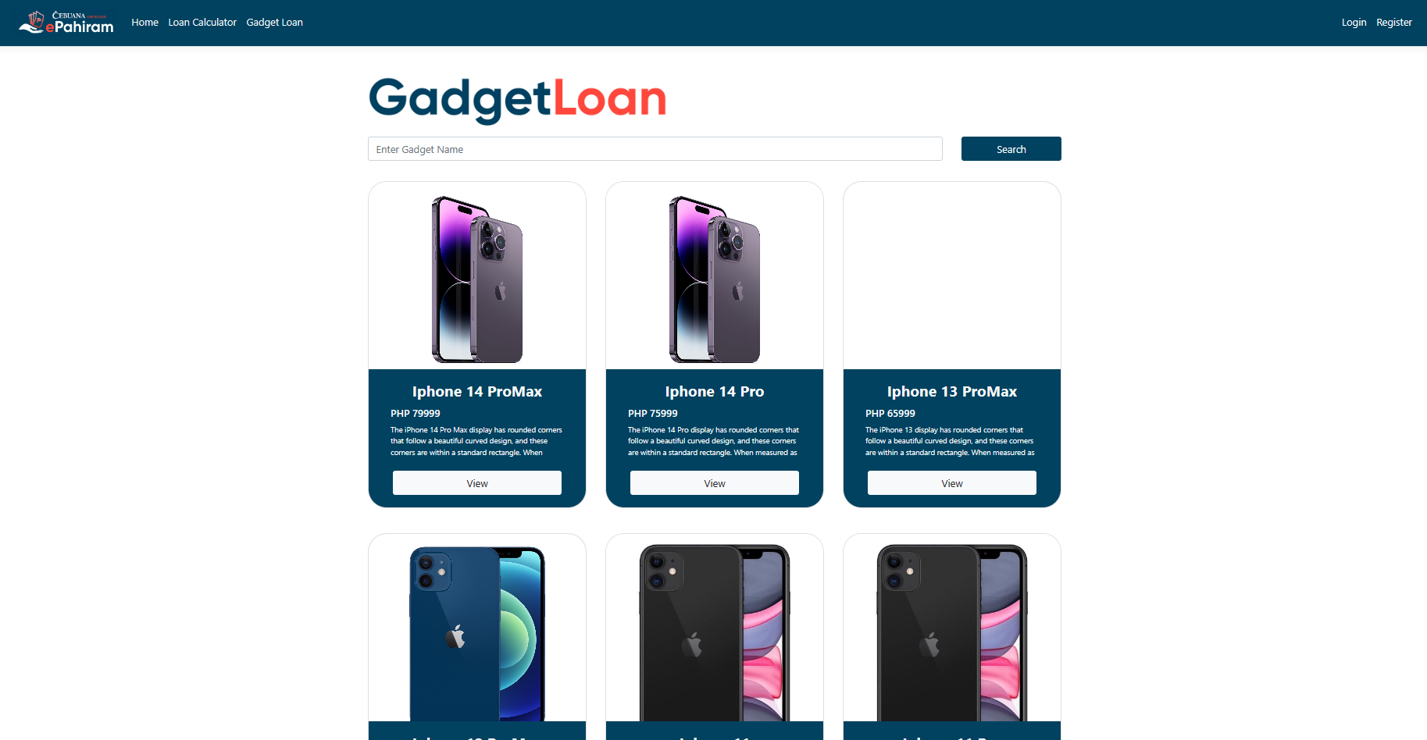
Important Features

Slide 22
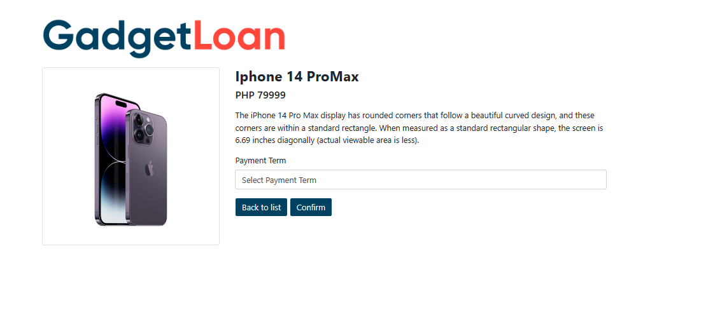
Important Features

Slide 23
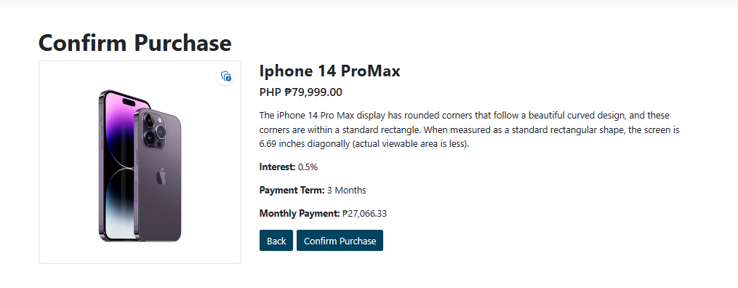
Important Features

Slide 24
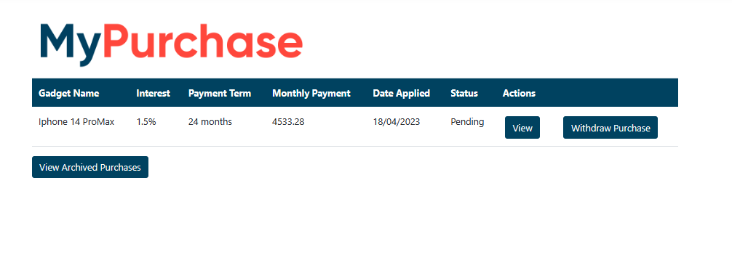
Important Features

Slide 25
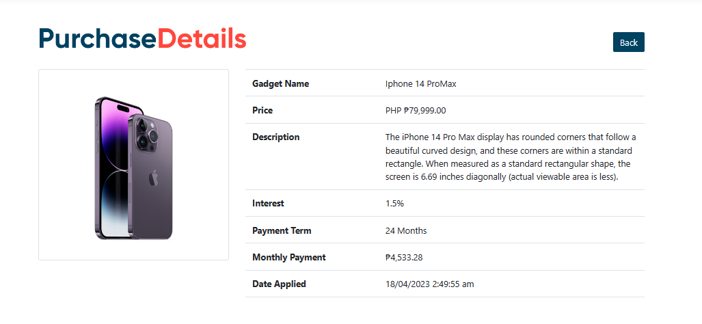
Important Features

Slide 26
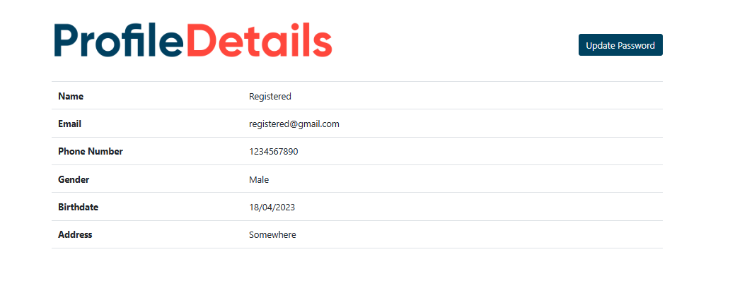
Important Features

Slide 27
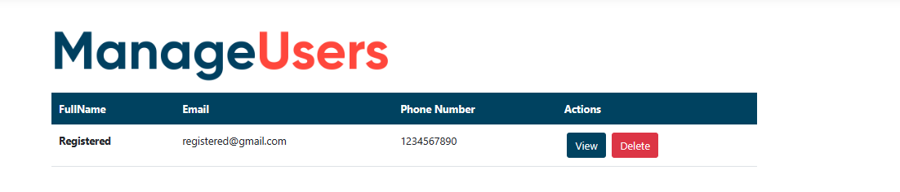
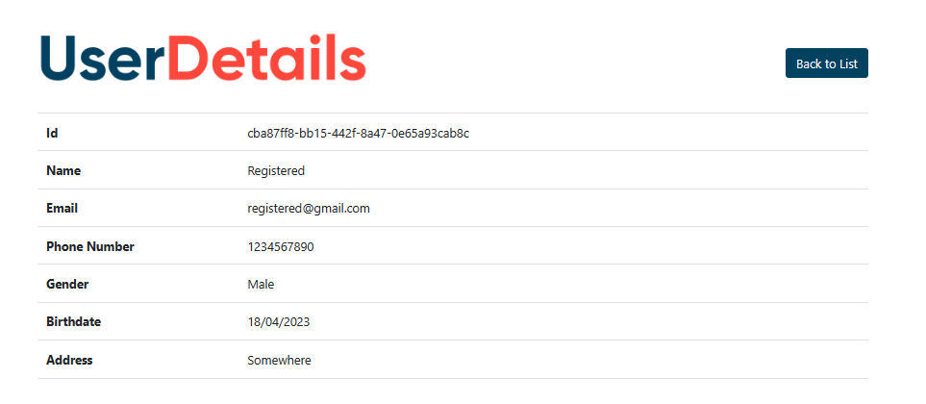
Important Features

Slide 28
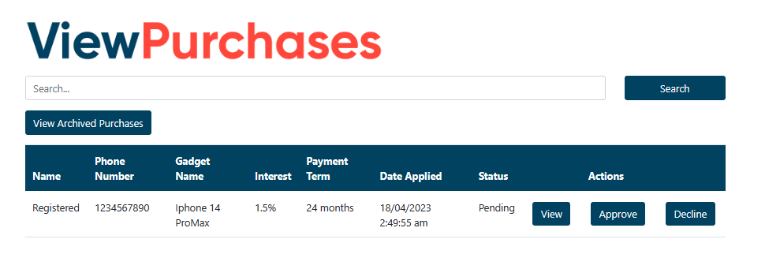
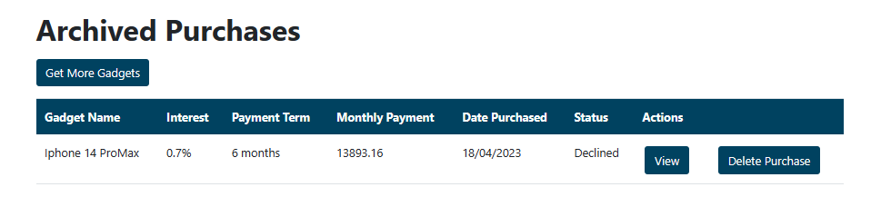
Important Features

Slide 29
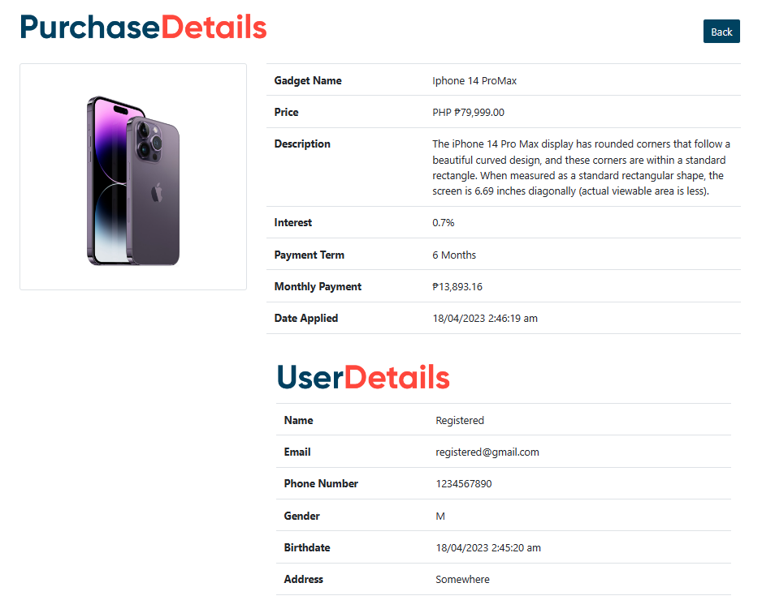
Important Features

Slide 30
Modules Done
John Jason M. Coligado:
Entity relationship in MVC
loan Calculator (formula and implementation)
EMI Formula for Gadget and Loan Calculator (Implementation)
Purchase Controllers
Jhansept Kylo Pandanan:
ER Diagram
Wireframes
Gadget Loan Implementation (CRUD)
UI

Slide 31
Implementation
Future Enhancement: Payment Options such as (Online Banking, Over the counter payment, and Cash payment thru PJLI).

Slide 32
Conclusion
This capstone project adds new features to the existing web application for micro-loans, which can compute the initial loan payment for the customer, provide a list of available loan gadgets, and the admin can change details and add new gadgets as needed, and finally, the user has a dashboard to view the purchase and existing payment terms. this web application should meet business standards.

Slide 33
Thank You
www.collaberadigital.com

